Slide 1
Sphere of influence, Affiliation, Account Hierarchy
LEVEL - PRACTITIONER

Slide 2
About the Author
Created By: | Arpita Bhattacharya, Saibal Roy, Supriyo Saha
Credential Information: | Associate – Projects; Sr. Consultant CRM – EAS Salesforce
Version and Date: | V1: 22-Jan-2018, V1.1: August-2023: Updated with Lightning UI
Modified By: | Abhijan Majumdar

Slide 3
Recap ...
In the previous Module – Account Object Configurations, you learnt to ...
  Define VEEVA Account record types
  Define custom Accounts fields
  Create custom page layout and record types
  Create a custom Account button
  Display the View User Territory custom link
  And now ...

Slide 4

Do You Know
The Sphere of Influence is a custom S-control called SphereofInfluence
The Influence association for Sphere of Influence can be disabled(Disabling Influence Direction)by disabling the FLS by profile
When Influence is disabled , a black line displays between the accounts, but an arrow will not display

Slide 5

Objectives
After completing this chapter, you will learn to:
  Define the s-Control: ‘Sphere of Influence’, which represents the Account affiliations in a pictorial format & Configure the Affiliations
  Define the Parent Child Relationship through Account Hierarchy &
  Configure an Account Hierarchy

Slide 6

Overview
  VEEVA CRM allows tracking Parent-Child relationships through Account Hierarchy
  The Sphere of Influence displays all account Affiliations in an intuitive, graphical format and can be placed on any Account or Contact page and displays all the relationships the current account has with other accounts (both HCP and HCO) and contacts
  Visibility to accounts and contacts in the Sphere of Influence is controlled by the territory hierarchy
  When deleting an affiliation record, the system
  deletes the inverse affiliation as well

Slide 7
Sphere of Influence & Affiliation

Slide 8
Affiliations - Overview
Account Affiliation
  VEEVA CRM allows Orgs to track non-formal affiliation within any types of Accounts through Account
  VEEVA CRM uses Affiliation_vod object to store affiliation information between person accounts, business accounts, and contacts
  When an affiliation (A->B) is inserted, the opposite affiliation (B->A) is automatically created via a trigger. This comes as a standard VEEVA functionality
  Account Affiliations is thus quite different from Parent Child relationships between Accounts
  Account Affiliations are depicted in pictorial form on Account card via the s-control: Sphere of Influence

Slide 9
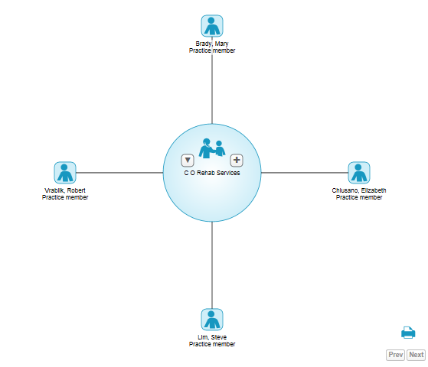

Sphere of Influence.. 1
Sphere of Influence
  Displays all the relationships the center account has with other accounts (of any type) and contacts
  Drives the list of potential attendees when recording group calls
  A VEEVA S-Control that can be placed on any Account or Contact page
  Click the to add an Account to the Sphere of Influence

Slide 10
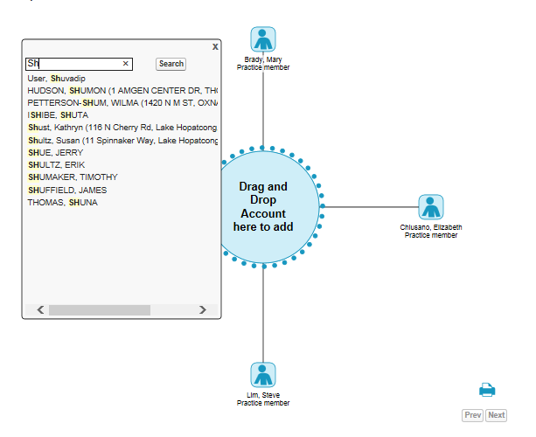
Sphere of Influence.. 2
Sphere of Influence
  Search for the Account
    Data access controlled by territory hierarchy
  Detail page of accounts outside the user’s territory is not visible

Slide 11
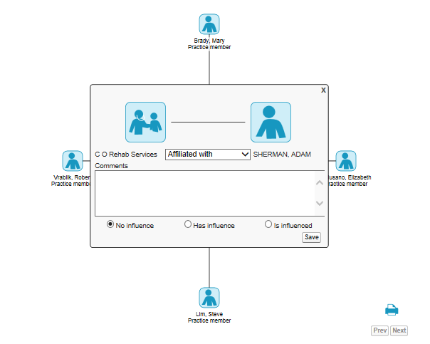
Affiliation Configuration.. 1
  Affiliation object stores Sphere of Influence data:
  Role picklist: values can be modified
  Comments: Text field
  Influence picklist: values must only be modified via Translation Workbench
    Do not change picklist values in the field definition
    Metadata is referenced by code to display the arrows properly
  From Account / To Account: fields used to build the affiliation between Accounts

Slide 12
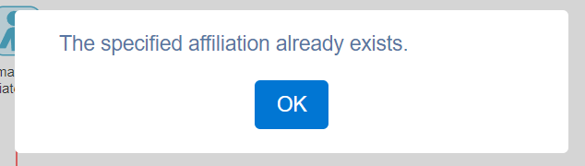
Affiliation Configuration.. 2
  Use Field-Level Security to hide fields such as Comments and Influence
  Do not hide the Roles field (or you will break the S-control)
  Rename section header on the Account page layouts if the Influence field is hidden
  A trigger prevents duplicate affiliation records for the same Account and Role
    Note:
      All fields for Affiliations have significant value and require special care
      Do not add, modify, or delete any fields in this object

Slide 13
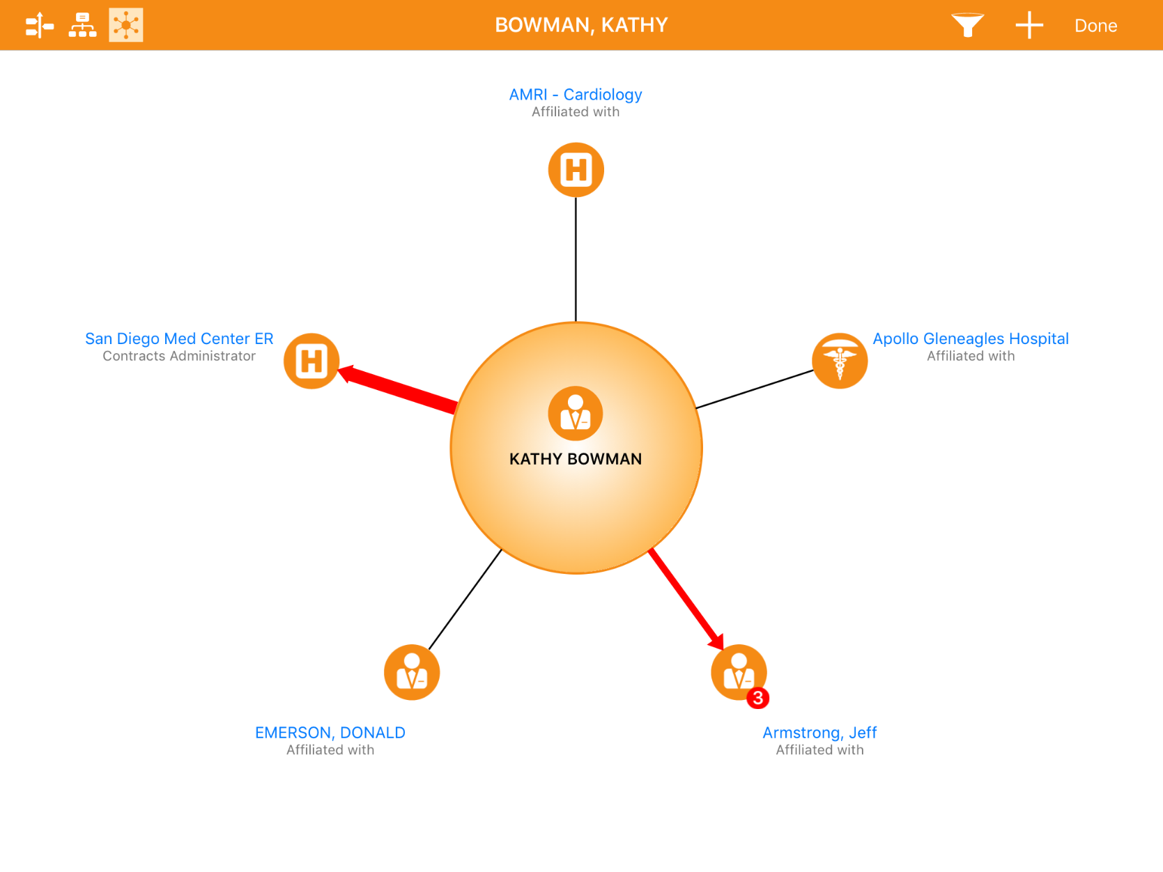
Sphere of Influence: Additional Features – CRM (iRep)
Relationship strength has 3
different line thicknesses
(Weak, Med, Strong)
Account Identifier (if any) will be shown below the account name
Affiliation Count badge gets
populated after clicking the
account name hyperlink

Slide 14
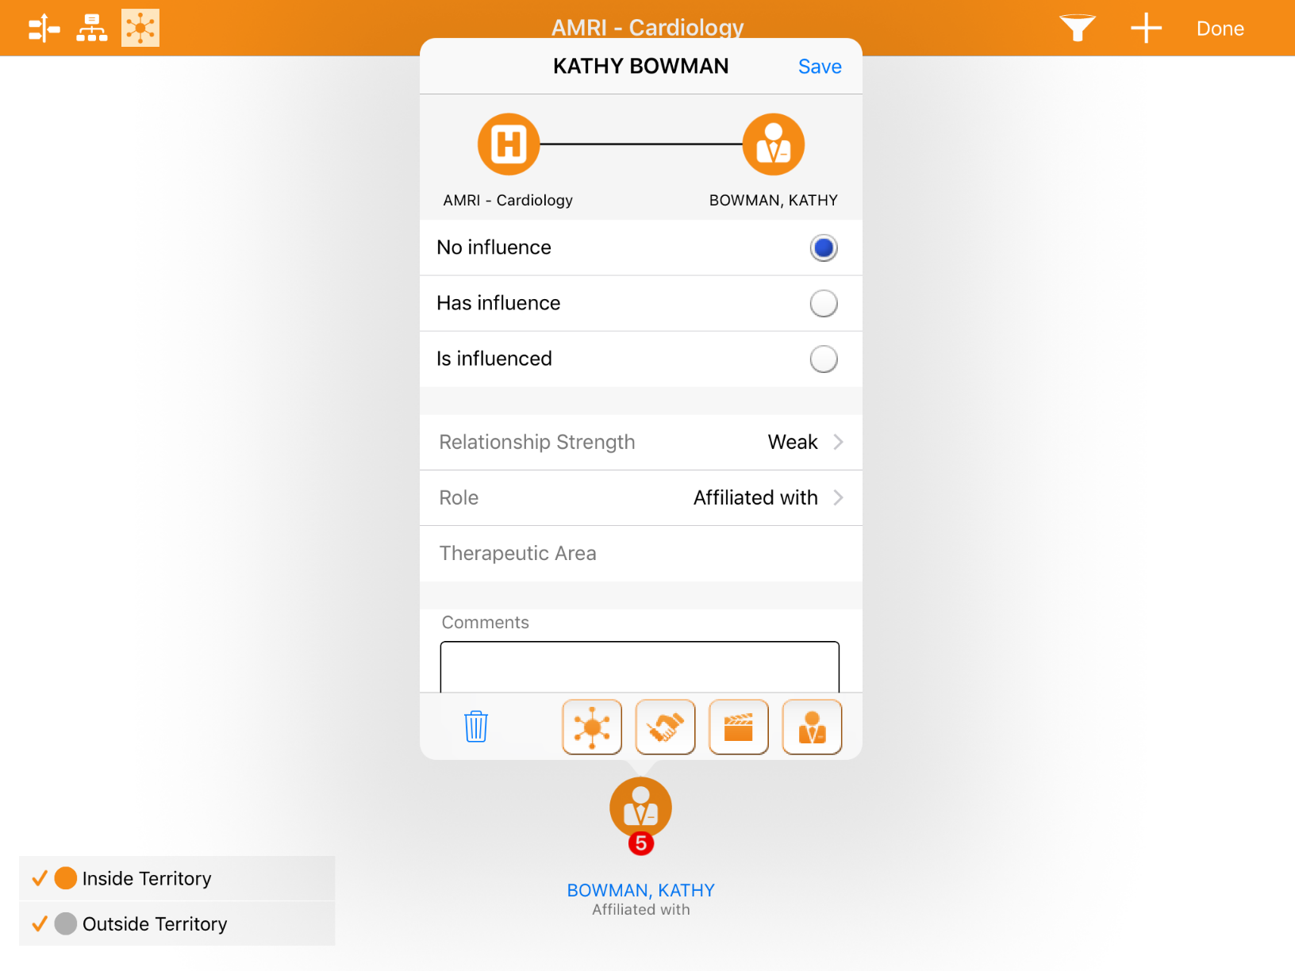
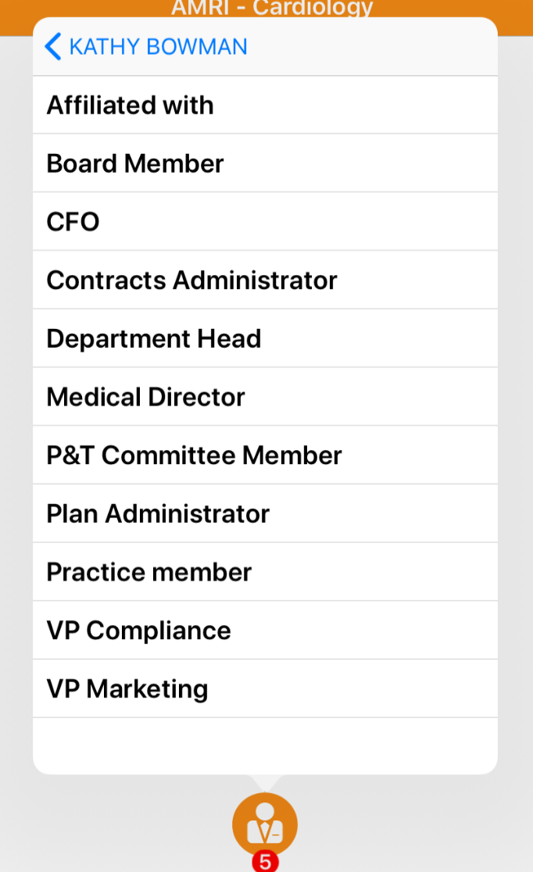
Sphere of Influence: Additional Features – CRM (iRep)
Tap on ‘+’ to create new affiliation
Tap on ‘Role’ to see options configured options

Slide 15
Sphere of Influence: Additional Features
The following features are available offline on CRM (iRep) only
  Enable features to enhance the Sphere of Influence UI
  Relationship strength can be viewed and defined by the thickness of the line between accounts
  Grant FLS access to the Relationship_Strength_vod field
  Affiliation count badge shows the number of affiliations the ‘To Account’ has, to quickly identify the most connected people
  Grant FLS access to the To_Account_Affiliation_Count_vod field
  Account identifier can be displayed if using it on the Account object
  Grant FLS access to the To_Account_Identifier_vod

Slide 16
Sphere of Influence: Additional Features
The following features are available offline on CRM (iRep) only
  The Sphere of Influence window displays up to 12 affiliations at once
    If there are more than 12 affiliations, then pagination controls display in the lower right corner of the window
  The user can also filter the affiliations based on Role, Account Type, and Influence
  CRM for iPad offers the ability to do more robust filtering with custom fields and the Relationship strength, Account Identifier, and Therapeutic Area
  Filtering on the Therapeutic Area is a ‘like’ clause, where the value chosen is a match among all values

Slide 17
Affiliation – Out of Territory 1
The following features are available offline on CRM (iRep) only
  Allow users to view out-of-territory affiliated accounts as long as one of the accounts within the Sphere of influence is in their territory
For example, Dr. Keller, who is in Jane’s territory, is affiliated with Dr. Kunis, Jane will be able see this relationship even if Dr. Kunis is not in her territory
  Grant user profiles FLS to the following fields
To_Account_Name_vod (Affiliation_vod object)
To_Account_Record_Type_vod (Affiliation_vod object)
Account_identifier_vod (Account object, for inside territory)
To_Account_Identifier_vod (Affiliation_vod object, for outside territory)
  Territory View Toggle is available on CRM for iPad. This toggle is set with the VEEVA Messages Labels
    TERRITORY_VIEW_INSIDE_TERRITORY
    TERRITORY_VIEW_OUTSIDE_TERRITORY

Slide 18

Affiliation – Out of Territory 2
User can toggle to show the inside and outside territory accounts

Slide 19
Account Hierarchy

Slide 20
Account Hierarchy - Overview
  Account Hierarchy- Person Accounts can be optionally configured to display in color based on gender
  Account Hierarchy- It is expected that customers will load data in both the Child_Account_vod objects and the value for the Primary_Account_vod field on the Account object
  Account Hierarchy and Sphere of influence visibility for Accounts outside the users Territory is only supported for offline devices

Slide 21
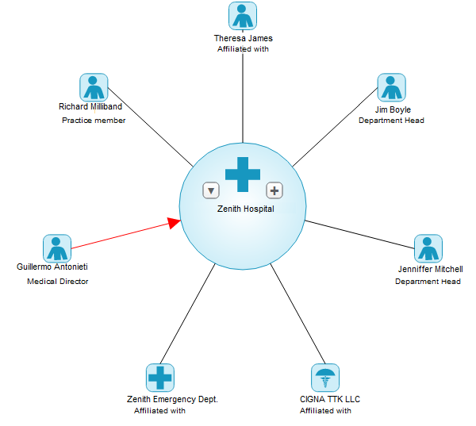
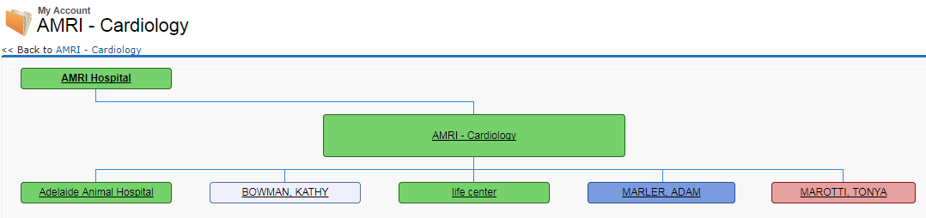
Account Hierarchy
Account Hierarchy vs. Sphere of Influence
Account Hierarchy | Sphere of Influence / Affiliations
Displays a hierarchy of parent accounts and child accounts | Displays affiliations between accounts
A structural relationship or physical layout of accounts | An informal relationship to convey influence between doctors
Example: Hospital, departments and the doctors in them | Example: High influence physician and his network
Cannot Designate roles and influence | Can designate roles and influence

Slide 22
Account Hierarchy Configuration 1
  Users click on the View Hierarchy button on an Account record to access its Hierarchy
    Must add View Hierarchy button to Account page layouts
  Profiles need CRUD permissions for Child_Account_vod object
    If users are not managing hierarchies, their profiles only need Read access

Slide 23
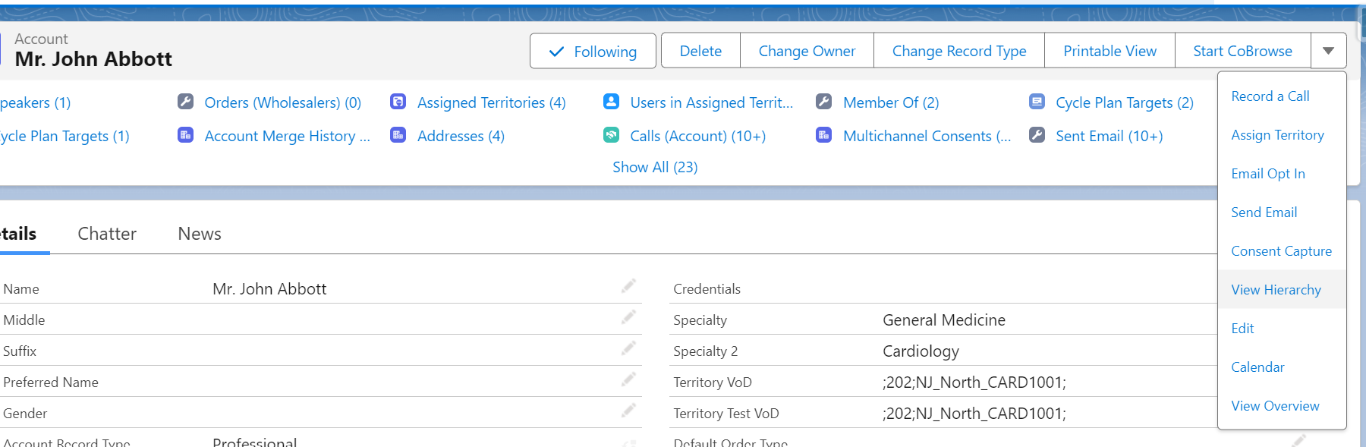
Account Hierarchy Configuration 2
  Users need to view and manage Account Hierarchy from the Professional page layout

Slide 24
Account Hierarchy – Configuration 3
  To configure the Accounts Professional page layout:
    Setup > Customize > Accounts > Person Accounts > Page Layouts
  Edit the Professional page layout:
Add the View Hierarchy button to the page layout
Add the Primary Parent field to the page layout
  Modify its property and make it read-only
  Add the Member Of related list to the page layout and:
    Remove the Name field from the Select Fields list
    Add the Parent Account Field to the Select Fields list
    Deselect the standard New button
    Add the New Parent button to the Selected Button list
  Enable Read/Edit permission on the Child Account object for user profiles

Slide 25
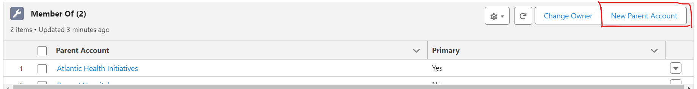
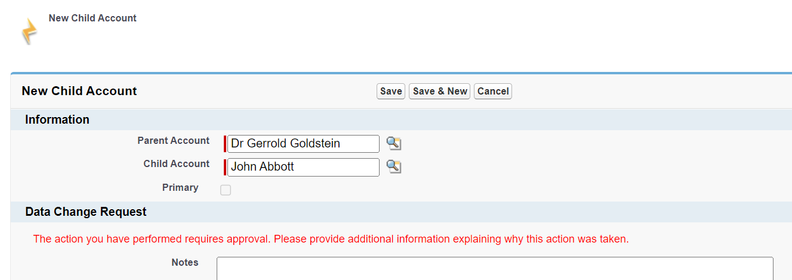
Account Hierarchy Related List
  Users can build account hierarchy from the ‘Member Of’ or ‘Members related list’
    Click the New Parent button
    Select the Parent Account to create the hierarchy relationship

Slide 26
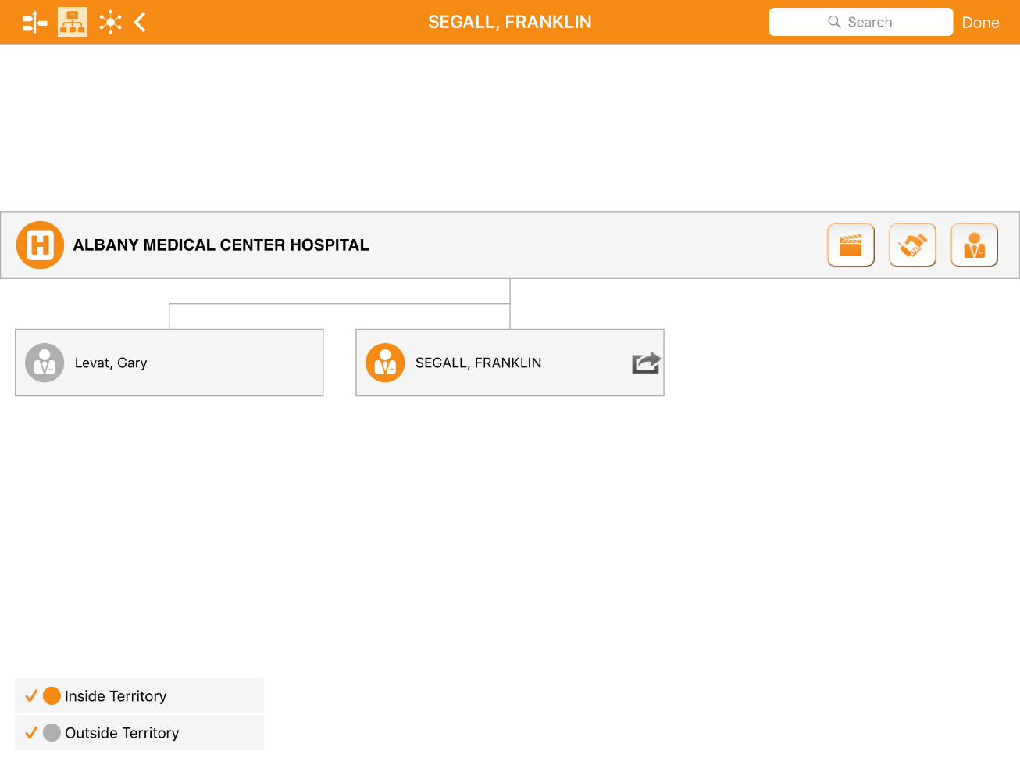
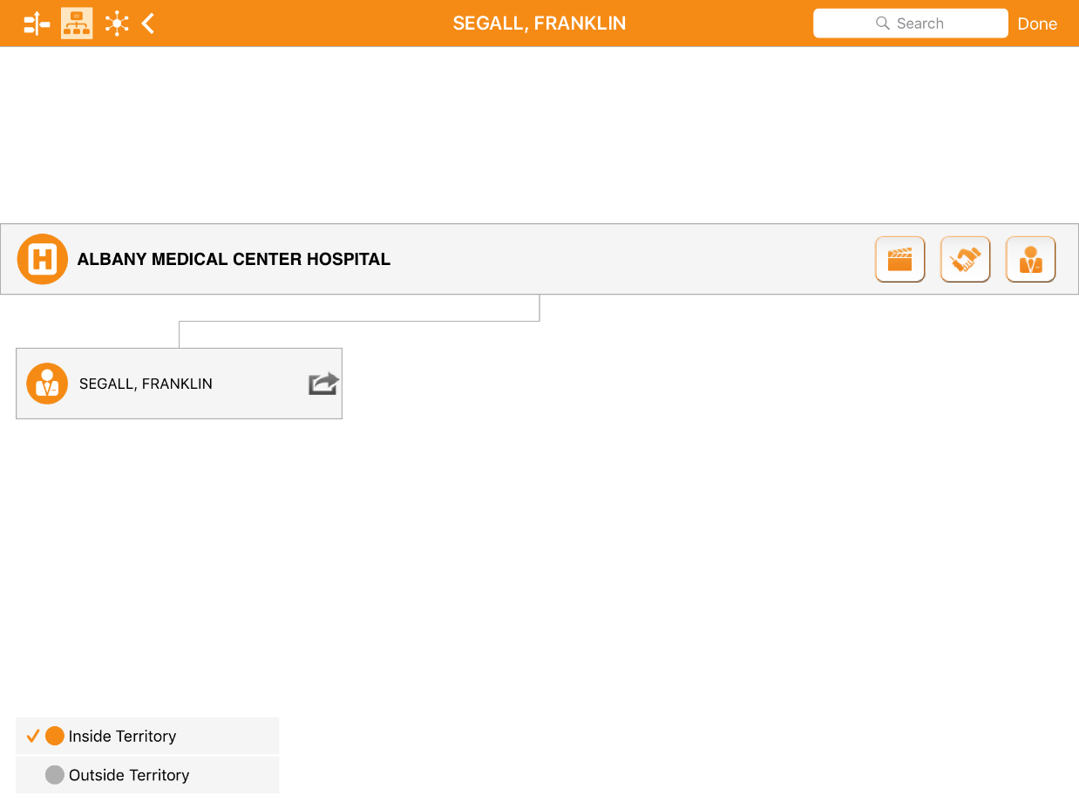
Account Hierarchy: Out of Territory – CRM (iRep)
Only inside territory accounts
User can identify which customers are out of territory by the color
Both inside and outside territory accounts
User can toggle between Inside and Outside territory

Slide 27
Child Accounts - Configuration
To enable Child Accounts:
  Enable the Enable Child Account VEEVA Setting
  Override the View button on the Child_Account_vod object with the View_Child_Account2_vod VisualForce page
  Grant Admin users FLS edit to the Source_vod field on the View_vod object
  Grant user profiles at least Read permission to the Child_Account_vod object
If Territories are being used:
  Grant Admin Users Read permission to the ChildAccount_TSF_vod object
  Grant all users FLS edit to the relevant fields on the ChildAccount_TSF_vod object
  Place the zvod_ChildAccount_TSF_vod marker field (on the Child_Account_vod object) on the appropriate page layout in a single column in its own section

Slide 28
Out of Territory - Affiliation & Child Account (iRep)
The following features are available offline on CRM (iRep) only
  Allow users to view out-of-territory accounts in the Account Hierarchy
  Grant user profiles FLS to the following fields in the Child_Account_vod
Parent_Name_vod
Child_Name_vod
The following features are available offline on CRM (iRep) only
  Allow users to view count of Account’s children in the UI
    Identify largest accounts in the territory
  Grant user profiles FLS to the following fields in the Child_Account_vod
    Parent_Affiliation_Count_vod
    Child_Affiliation_Count

Slide 29



Account Hierarchy: Child Count – CRM (iRep)
Count includes accounts from
inside and outside territory if
configured to show
Badge will appear if there are child accounts

Slide 30
Check Your Understanding 1
How many accounts are shown in a single page in Sphere Of Influence in iRep?
10
12
8
Admin can configure
Answer: 12
© Cognizant 2023

Slide 31
Check Your Understanding 2
Sphere of Influence can be configured to show out of territory but affiliated accounts in iRep?
TRUE
FALSE
Answer: TRUE
© Cognizant 2023

Slide 32
Check Your Understanding 3
Child Accounts can be configured to show out of territory but related accounts in iRep?
TRUE
FALSE
Answer: TRUE
© Cognizant 2023

Slide 33

Summary
In this module you have learnt to:
  Define the s-Control: ‘Sphere of Influence’, which represents the Account affiliations in a pictorial format & Configure the Affiliations
  Define the Parent Child Relationship through Account Hierarchy &
  Configure an Account Hierarchy

Slide 34

Source
https://crmhelp.veeva.com/doc/Content/Home.htm
Disclaimer: Parts of the content of this course is based on the materials available from the Web sites and books listed above. The materials that can be accessed from linked sites are not maintained by Cognizant Academy and we are not responsible for the contents thereof. All trademarks, service marks, and trade names in this course are the marks of the respective owner(s).

Slide 35
Coming Next..
In the upcoming module – Address, TSF and Account Merge, you will learn to,
  Define & describe VEEVA Address, its specific fields & type
  Identify the objects used to hold a new Address, Territory Specific Fields(TSF)
  VEEVA managed attributes for TSF and TSF configuration
  Describe the account merge functionality used to merge two or more duplicate accounts
35

Slide 36
Thank you
  You have successfully completed
  Sphere of influence, Affiliation, Account Hierarchy

